Slide 1
Identifying factors associated with failure of Thailand National Licensing Examination step 1 : a case study at Faculty of Medicine Ramathibodi Hospital, Mahidol University
Kodchapon Bunkosang
The degree of master of Science in Biostatistics
Faculty of Public Health, Mahidol University
Educator,
Faculty of Medicine Ramathibodi Hospital, Mahidol University

Slide 2
INTRODUCTION
1
Failure rate of licensing examination
0.84-19.7% (2006-2016)
Objective: To identify the factors associated with failure the NLE step 1
Important of licensing examination
Resident
Actual practice
Health of people
Effect of failure the LE : loss of human resource, future of medical student.

Slide 3
METHODOLOGY
Study design : Retrospective cohort
Population : Medical students in Ramathibodi
Sample : Admission in 2014 – 2016
2
Sample size : 524 medical students
Inclusion criterions
- admission in 2014 - 2016
Exclusion criterions
- schedule does not follow the curriculum
- admission by Mahidol University Scholarship Project
Individual and Admission factors
Gender
High school background
Admission type
Academic performance factors (111)
Course grade (51)
Cumulative GPA (9)
Number of failures
in each subject (51)
The result of NLE step 1
The software in this study is the STATA program
randomly 10% / 90%
The model will be developed by stepwise: multilevel regression modeling
1. admission model 2. end of haft year 1 model
3. end of year 1 model >>>> 7. end of year 3 model.
Improvement test
The models accuracy: 10% random data, sensitivity, specificity, and AUC analysis.

Slide 4
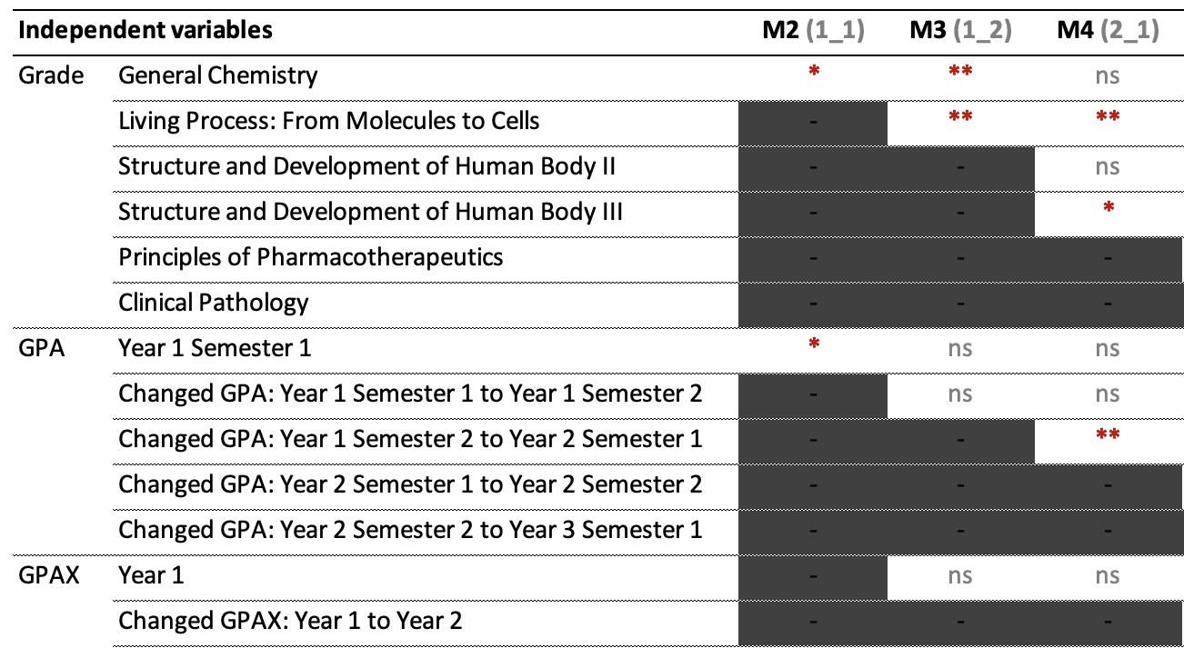
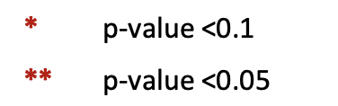
Results
3

Slide 5
RESULTS
4
The suitable model
Variables | Coefficient | OR | SE (OR) | 95% of OR
1. General Chemistry | 0.544 | 1.722 | 1.251 | 0.415 | 7.148
2. Living Process: From Molecules to Cells | 1.051 | 2.860 | 1.050 | 1.392 | 5.875
3. Structure and Development of Human Body II | 0.177 | 1.194 | 0.494 | 0.531 | 2.685
4. Structure and Development of Human Body III | 1.570 | 4.807 | 2.171 | 1.984 | 11.647
5. Changed GPA: Year 1 Semester 2 to Year 2 Semester 1 | -1.773 | 0.170 | 0.123 | 0.041 | 0.706
$$\log\left(\frac{p_{ij}}{1−p_{ij}}\right)=−3.991+0.544\left(GenChem\right)+1.051\left(Molecule\right)+0.177\left(Structure1\right)+1.570\left(Struture2\right)−1.773\left(ChangedGPAtoY2_{S1}\right)+u_{i}$$

Slide 6
Discussion
4
Consistent with the previous studies, they used admission and academic performance factor to predict LE score in USA medical schools.
Additionally, when considering the subjects associated with the NLE Step 1 failure, they correspond to both sections of the NLE Step 1 exam: General Principles and Organ systems.

