Slide 1
Kick-starting your qualitative research:
Methodology and research design
Bangkok, July 2022
Fred Stevens
Winitra Kaewpila

Slide 2
Welcome to the dark world of qualitative research…

Slide 3
What do you know?
Who am I?
Who are you?
Background
Experience with qualitative research

Slide 4
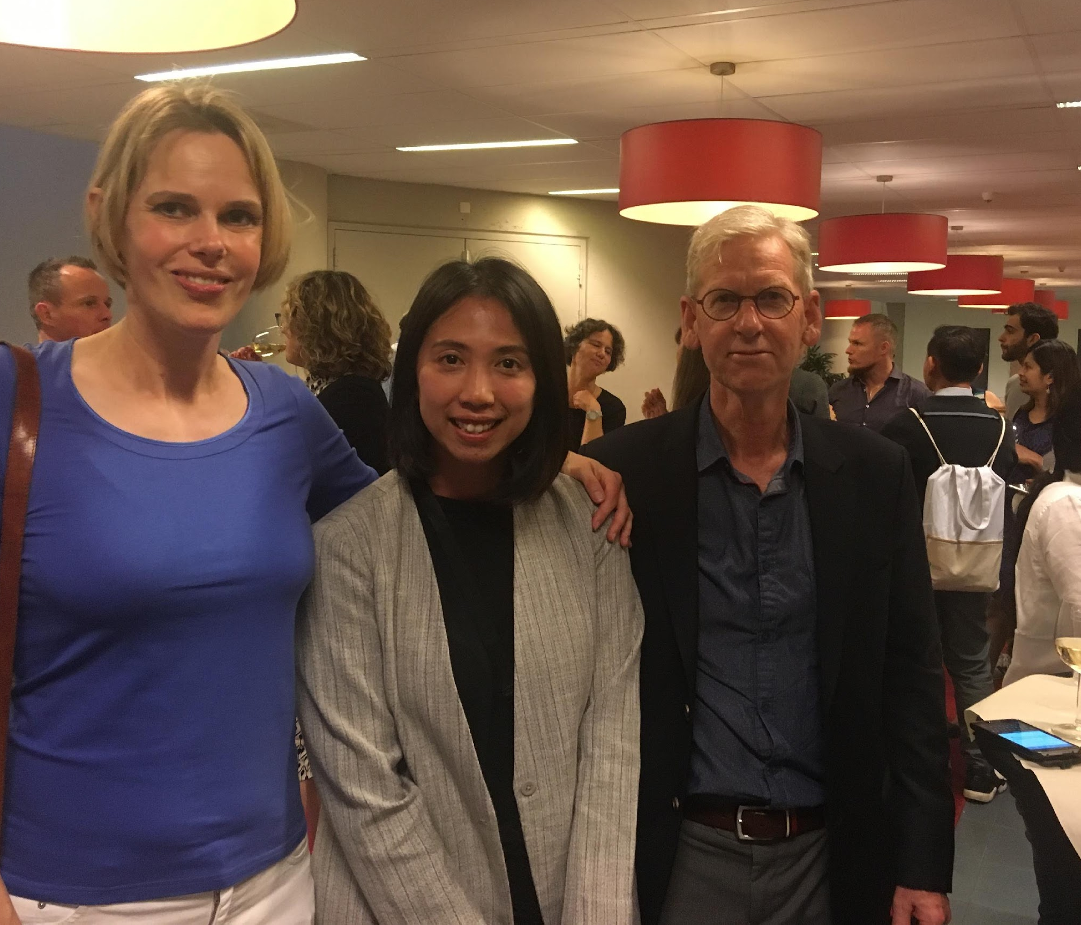

Slide 5
Workshop 1: Methodology and research design
AIM:
Overview of qualitative research principles
Qualitative research questions
Overview of most popular qualitative research designs and when to apply
Your own ideas for a qualitative study??

Slide 6
Principles of qualitative research

Slide 7
Roots of qualitative research
Anthropology
Interpretive Anthropology -> ‘Thick description’ (Clifford Geertz)
Emic-etic issues (insider – outsider)
Sociology
Verstehende Methode (Max Weber)
: understanding from the perspective of the actor
symbolic interactionism->grounded theory (Chicago school)
Symbolic Interactionism (Erving Goffman)
Philosophy
Phenomenology (how do we experience being in the world)

Slide 8
Why the using of qualitative research
Human behavior can only be understood in its socio-cultural, political and economic context
The study of human interpretation, contribution of meaning and human experience.
The study of culture “emically” (from the inside)
Human conduct cannot be reduced to a set of isolated variables

Slide 9
Qualitative
Quantitative
Correlations
Extent
Chance and risk
Predictive
Statistical
Objectivist
Nature of phenomena
Natural context
Meaning, perceptions
In-depth understanding
Open nature
(Inter-) subjective
Dynamics

Slide 10
Another way of classifying research traditions
By their assumptions:
concerning the “nature of reality” (Ontology)
concerning the “knowledge claims”(epistemology)

Slide 11
Ontological considerations
Objectivism: social phenomena are external facts beyond our influence
Constructivism: social phenomena are being produced by social actors through interaction
Example: The medical school/hospital as
an organisational system or as a ‘negotiated order’

Slide 12
The hospital as an organizational system

Slide 13
The hospital as a negotiated order
A hospital is not a stable system but the outcome of stakes that tends toward homeostasis.
Negotiations take place at the workplace to come to temporary work structures.
Rules and procedures are constantly produced and changed through interaction and negotiation.

Slide 14
Epistemological considerations
How can I know reality/knowledge?
Natural sciences Vs social world
Positivism: application natural science model
‘we study objective reality by observation, hypothesis testing, laws’
Interpretivism: ‘there isn’t objective reality outside ourselves’
“Verstehen” phenomenology, understanding how people make sense of the world

Slide 15
CROWD MISTAKES RESCUE ATTEMPT, ATTACKS POLICE, November 23
“Three policemen giving a heart massage and oxygen to a heart attack victim Friday were attacked by a crowd of 75 to 100 persons who apparently did not realize what the policemen were doing. Other policemen fended off the crowd of mostly Spanish speaking residents until an ambulance arrived. Police said they tried to explain to the crowd what they were doing, but the crowd apparently thought they were beating the woman. Despite the policemen’s efforts the victim, 59 years old, died.”

Slide 16
Paradigms and worldviews

Slide 17
Paradigms and worldviews
(Post) positive: deterministic view of causes and effects; reductionist
Social constructionist: understanding the world; focus on context, interaction, theory generation
Transformative/advocacy/participatory: political; inequality; empowerment; collaborative; emancipation; change-oriented
Pragmatism: what works at the time? Problem- centred; pluralistic; real-world practice oriented

Slide 18
Characteristics qualitative research
Open data collection techniques
Aimed at unraveling complex processes and mechanisms that constitute contexts
Variety of methods
Focus on (construction of) meaning/perceived truths (facts), interpretation and experience
Digs deep
Reflexive

Slide 19
Reflexivity in Action 1
https://www.youtube.com/watch?v=5g_XXoZIo4k&t=309s
Watch the video
Observe your reactions to what is being told
Which part of you is reacting to this?
Discuss in Breakout room your observations
Were your responses similar?

Slide 20
Reflexivity in Action 2
Read the following text (3 minutes)
Re-read and jot down on paper words or phrases about what you see in the text (5 minutes)
Discuss in subgroups (10 minutes)
Why did you see what you saw in the text?
How might another person see it differently?
What insights did your peer contribute?

Slide 21
“I was in a multi-disciplinary foot clinic and a man came in and he’s severely obese and he was wheeled in by the paramedics and it was all it was, I didn’t know whether I was supposed to be there or whether I wasn’t supposed to be there and there was a lot of medical staff around and nobody was really communicating with me but I obviously wasn’t allowed to disappear because as a medical student you’re not allowed to leave but you’re not welcome to stay. Erm, they took all of his bandages off and he’s just in quite a bad way really of self-neglect and it was obviously quite humiliating for him to be there and he was surrounded by all these people, and I just generally felt quite ignored. Nothing was being explained to me and the whole, his legs were essentially rotting away so it smelt horrible, and it looked horrible and in the end I got so stressed out by it all I just ended walking out into the reception and bursting into tears, I was like, cos it’s horrible, so that was something that sticks out in my mind, a bad thing. I was in a good mood when I got there, then when I realised what the clinic entailed, I think my mood fairly quickly…”

Slide 22
Reflexivity
Being reflective of implications of methods, values, biases, decisions, for the knowledge of the social world the researcher generates
Being sensitive to the researcher’s cultural, political and social context
Being self-critical of beliefs and assumptions
Taking account of one’s relationship with those whom one studies

Slide 23
Reflexivity
Possible issues
Possible power difference between researcher and participant
Background researcher
Health Care Professional vs. Patient, Teacher vs. Student
Gender, race, occupation, social status can influence choice made
Theory used
Managing it
Reflexive diary
Peer debriefing
Describe in your paper
Characteristics of the research and the research that could act as ‘confounders’
Theory used in the designing of the research
Realist tales: confident, dispassionate third-person accounts of culture
Confessional tales: detailing how research was carried out

Slide 24
Main steps
General research questions
Selection of site(s) and subjects
Collection of relevant data
Interpretation of data
Conceptual and theoretical work
(tighter RQs, collection of further data)
Writing up findings

Slide 25
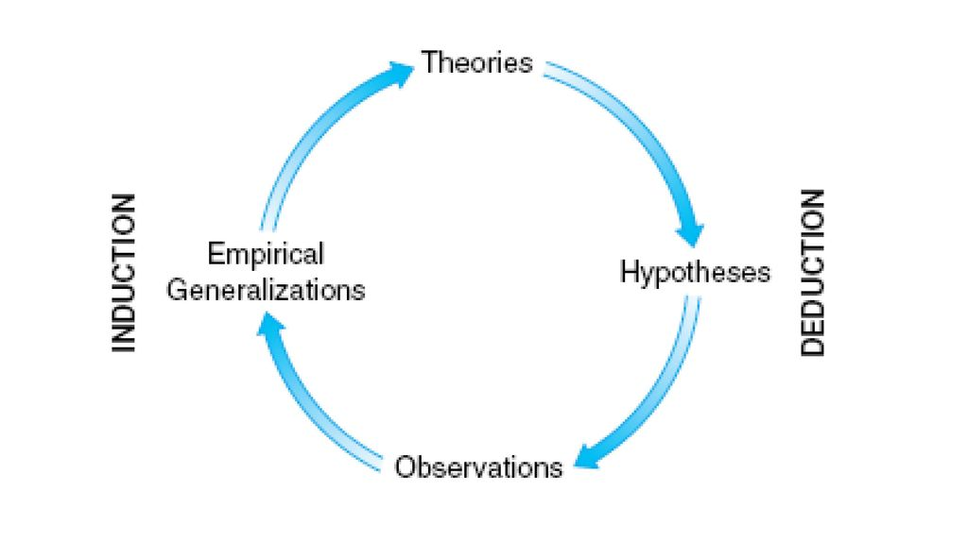
The process of deduction and induction
Quantitative
testing of theory
natural science model
positivism
Qualitative
Generation of theory
Interpretivism/constructivism

Slide 26
Research Questions in Qualitative Research
Varying degrees of explicitness:
‘We thought to understand…’
Versus
- What resources do students use?
- What notions do teachers have about…?
- How do our respondents create a new balance of activities after moving into the clinical years?

Slide 27
What do you think of the following qualitative research questions?
Should philosophy be included in the medical school curriculum?
What is the best way to teach professional behaviour?
What would medical schools be like today if COVID-19 had not occurred?
How can deans improve faculty morale at low performing faculty departments?

Slide 28
Characteristics of Good Research Questions
The question is feasible (i.e., it can be investigated without expending an undue amount of time, energy, or money).
The question is clear (i.e., most people would agree as to what the key words in the question mean).
The question is significant (i.e., it is worth investigating because it will contribute important knowledge about the human condition).
The question is ethical (i.e., it will not involve physical or psychological harm or damage to human beings or to the natural or social environment of which they are a part).

Slide 29
How would you translate the following aims into research questions?
To explore the teaching and learning processes that occur in morbidity & mortality rounds in order to understand their role in, and contribution to, the current medical education context.
To investigate undergraduate medical students’ experiences of the phenomenon of empathy during the course of their medical education and to explore the essence of their empathy.
To compare two learning cultures – those of music and medicine – in order to unearth assumptions about learning that are taken for granted within the medical culture.

Slide 30
Discussion

Slide 31
Coffee time!

Slide 32
METHODOLOGIES AND RESEARCH DESIGNS

Slide 33
What is Methodology
A general (scientific) approach to studying research topics
Strategic approach to answering the research question and to gain knowledge (research design)
Different approaches provide different answers
A structure according to which you collect your data (because alignment is KEY)

Slide 34
Structure according to which to collect data
Usually not referred to as “design”
Usually no pre-fab designs in qualitative research
Though it is possible to follow the quantitative designs
Yet, your work plan rather depends on what you want to know is following from:
Paradigm (ontology, epistemology, methodology)
Theoretical work within your paradigm
Research questions and objectives

Slide 35
But there is something that is called “strand” or “strategy” or “approach”
Phenomenology (Philosophy, sociology)
Grounded theory (Sociology)
Ethnography; (Thick description; Anthropology)
Case study (Sociology, Eclectic)
Participatory action research (Critical theory?)

Slide 36
Phenomenology

Slide 37
Phenomenology
Approach which uses in-depth exploration of the experiences of individuals to discover the essence of a phenomenon
Central aim:
To understand the essence of a social phenomenon from the perspective of those who have experienced it
The phenomenologist attempts to see things from that person’s point of view
N.B. Originates from philosophy (Husserl, Heidegger, Merleau-Ponty)

Slide 38
Phenomenology
The search for meaning or understanding of a phenomenon, that is anything that appears or presents itself, as one experiences it (Hammond, 1991)
Allows researchers to gain insights that inform practice strategies and enhance practitioners’ understanding of, and sensitivity to, those they serve
‘What is the nature of caring?’
‘What is the meaning of health for those living with chronic illness?’,
‘What is students’ first year experience of university life?’

Slide 39
Phenomenology – Main Assumptions
Suspension of judgement/being neutral
Process of recognising and setting aside preconceptions about the phenomenon under consideration (bracketing, suspension of judgement)
Essence
That which makes a phenomenon what it is
Lifeworld
The world of concrete experience as it is lived by people

Slide 40
Potential to promote:
Human development
Enhance professional practice
Advance foundations of disciplines
Inform programs and services
Philosophy or social research?
Methodology or paradigm?
Description or interpretation?
It depends……☺

Slide 41
Core concept: Being
Essence of human experience
Being in your body, being your body
Being in Space
Being in Relationships
Being in time
Analysis
Significant statements
Generation of meanings units
Essence description

Slide 42
Grounded theory

Slide 43
Grounded Theory
Systematic, qualitative procedure used to generate a theory that explains, at a broad conceptual level, a process, an action, or an interaction about a substantive topic
Central aim
Generate theories regarding social phenomena by developing higher level understanding that is ‘grounded’ in, or derived from, a systematic analysis of data

Slide 44
Grounded Theory
Reality too complex, should not be reduced to a priori theoretical simplifications
Theory should rise from reality; should be grounded in that reality => Grounded theory
Close look at natural settings, no theoretical concepts as starting point
Looks for patterns in natural data
Verifies/falsifies those patterns etc.
Cyclic

Slide 45
Grounded Theory – Main Features
Iterative study design
Cycles of simultaneous data collection and analysis
Theoretical sampling
Sample is not set at the outset but selected purposefully as the analysis progresses
Constant comparison (during data-analysis)
Emerging theoretical constructs are continually being refined through comparison with ‘fresh’ examples
Open & axial coding
Memo-writing (during data-analysis)
Record thoughts and decisions about patterns in the data
Helps you to make early and ongoing links between the empirical world and theoretical ideas

Slide 46
Ethnography

Slide 47
Ethnography
Qualitative research procedures for describing, analysing, and interpreting a group’s shared patterns of behaviour, norms, values, beliefs, that develop over time

Slide 48
Ethnography
Central aim
To provide rich, holistic insights into people’s views and actions, as well as the nature of the location they inhabit
Main features
Cultural themes: general position, declared or implied that is openly approved or promoted in a society or group
Shared patterns of norms, values, beliefs, behaviours

Slide 49
Ethnography – Main Features
Fieldwork: Data collection through observation and interviews
Looking for
Cultural themes: general position, declared or implied that is openly approved or promoted in a society or group
Shared norms and values, patterns of behaviour, beliefs
The use of ‘thick’ descriptions
Selection of key informants and settings
The emic-etic (=insider-outsider) dimension
Whose language you use

Slide 50
Ethnography
Thick description
Map of, and for, reality (meaning and behaviour in context: power, practices, institutions etc.)
Interactions between human and non-human dimensions, local context and beyond
Interrelationships of these issues

Slide 51
Strand/strategy can be recognized by workplan
Phenomenology: questions about experience (not about meaning!): in-depth conversations about the phenomenon studied; diaries etc.
Grounded theory: evolution of experience and meaning; “data-driven”, variety of data collection techniques, cyclic work plan
Ethnography: is after thick descriptions: variety of data sources

Slide 52
Which design would you choose for the following research questions?
Which teaching and learning processes occur in morbidity and mortality rounds and what is their role in, and contribution to, the current medical education context?
What are undergraduate medical students’ experiences of the phenomenon of empathy during the course of their medical education and what is the essence of their empathy?
What are the differences in learning cultures between music and medicine and, on the basis of this, what are the assumptions about learning that are taken for granted within the medical culture?

Slide 53
Kuper et al. Teaching and learning in morbidity and mortality rounds: an ethnographic study. | Tavakol et al. Medical students’ understanding of empathy: a phenomenological study. | Watling et al. Music lessons: revealing medicine’s learning culture through a comparison with that of music.
Explored the teaching and learning processes that occur in M&MRs in order to understand their role in, and contribution to, the current medical education context. | Investigated undergraduate medical students’ experiences of the phenomenon of empathy during the course of their medical education and to explore the essence of their empathy. | A comparative examination of two learning cultures – those of music and medicine – in order to unearth assumptions about learning that are taken for granted within the medical culture.
Ethnography | Phenomenology | Constructivist grounded theory
Observation, interviews | In depth interviews | Focus groups
Theoretical sampling Data triangulation
Concurrent analysis
Field notes, meetings, reflexivity, audit trail | Researcher meetings | Independent analysis, meetings to reach agreement

Slide 54
(Your turn) quick-starting your own research
Problem/topic?
Aim?
Research question?
Methodology?
…..

Slide 55
Literature
Creswell, J. W. (2014). Research design: Qualitative, quantitative, & and mixed methods approaches. London: Sage (4th edition).
Field, A. (2008). Discovering statistics using SPSS. London: Sage.
Babbie, E. (2008). The basics of social research. Belmont CA: Wadsworth.)
Bryman, A. (2012) Social research methods. Oxford: Oxford University Press
Fraenkel, J., Wallen, N., Hyun, H. (2011) How to Design and Evaluate Research in Education. New York: McGraw-Hill

