Slide 1
Practical guide to meta-analysis of rare events
Nichawan Koompong, MD

Slide 2
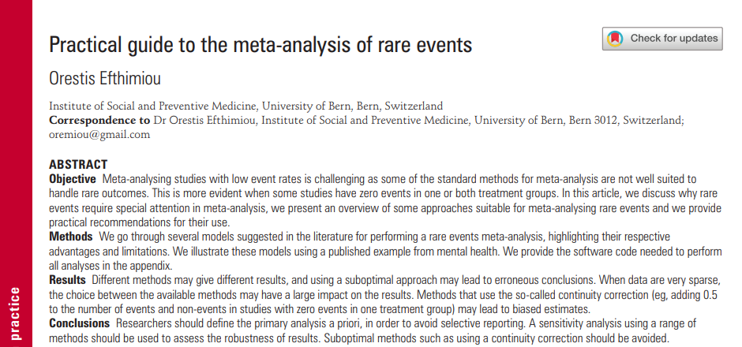
Evid Based Mental Health, 2018
Notes:
This article overview some approaches suitable for meta-analysis reare event and provide practical recommendation for their use

Slide 3
Outline
Introduction
Method
Inverse-variance method
Peto’s method
Mantel-Haenszel meta-analysis
Bayesian meta-analysis
Beta-binomial model
Arcsine difference
Others
Illustrative case study

Slide 4
Double –zero studies
The Cochrane handbook:
Excluded from the analysis
However,
An ethical point of view, patient in the studies deserve to be included in the analyses.
The studies may carry information of relative treatment effects through their sample size.

Slide 5
Inverse-variance method
Calculate treatment effect in each study along with standard error (SE), odd ratio (OR), risk ratio (RR) or risk difference (RD) for binary outcome
Then synthesized at second level across studies
Calculating TE in terms of OD or RR becomes impossible.
Continuity correction
Use risk difference to measure relative effects

Slide 6
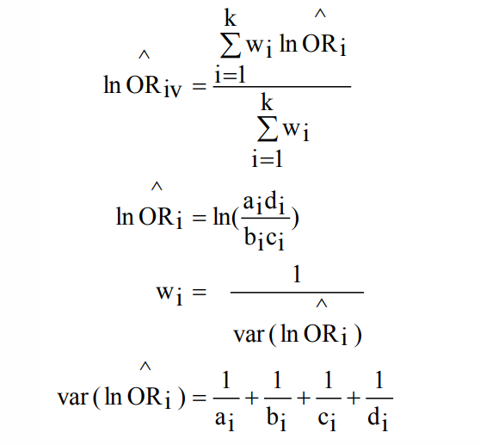
Pooling ORs

Slide 7
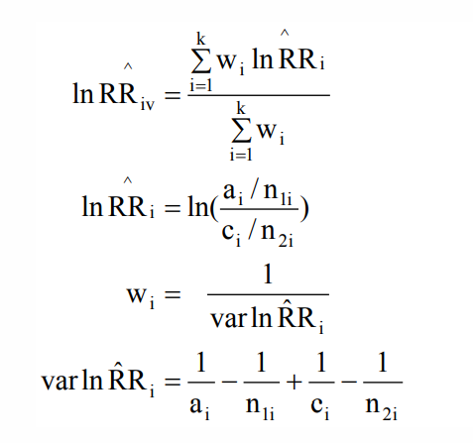
Pooling RRs

Slide 8
Continuity correction
Correct the data by adding fixed value (typically 0.5) for studies with zero events in one of their arms
Allow the use of standard inverse variance method

Slide 9
Continuity correction and using risk difference leads to excess bias in the estimated effects.
The risk difference method have poor statistical properties when events are rare. (too wide interval and low power)

Slide 10
Peto’s method
Fixed effect method used to estimate ORs
Limitation : cannot account for heterogeneity between trials
Double zero study are excluded.
Peto’s OR works well when
The event is rare (<1%).
Treatment group are balanced.
The effect size are not very large.

Slide 11
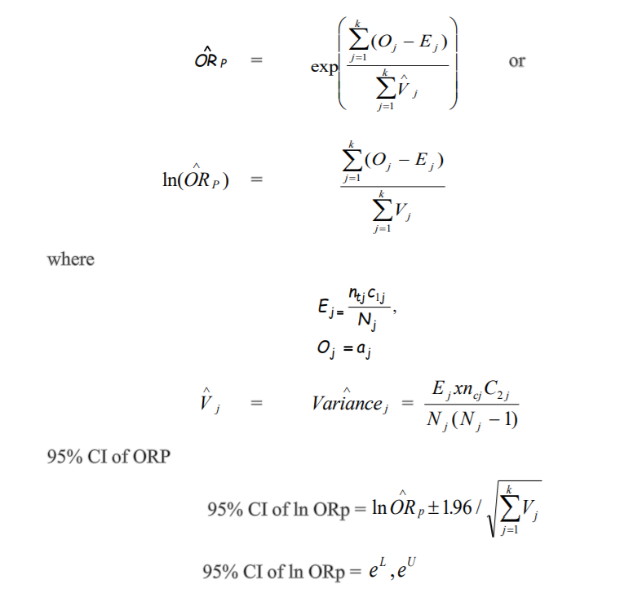

Slide 12
Mantel-Haenszel meta-analysis (MH)
Fixed effects meta-analysis
It can be used for ORs, risk ratio or risk difference.
The method incorporates evidence from single-zero studies without requiring continuity corrections, unless the same cell in 2×2 table is zero for all studies. Thus, the method requires continuity correction much less often.

Slide 13
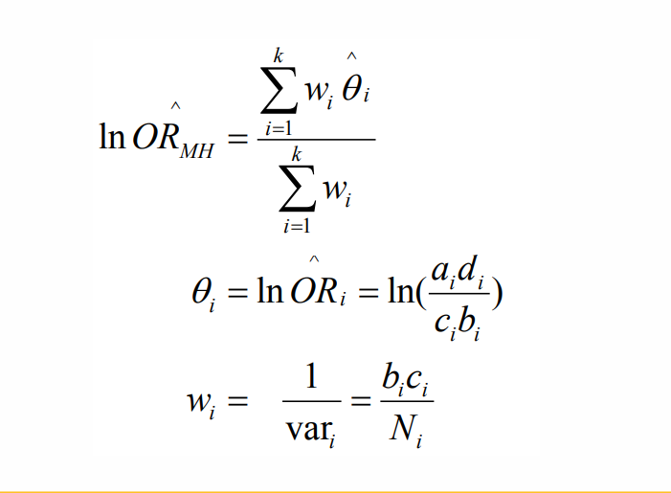
Mantel-Haenszel meta-analysis (MH)

Slide 14
Mantel-Haenszel meta-analysis
The MH method excludes double-zero studies from the analysis, unless risk difference is used.
In some situation that Peto’s method is performed poorly, MH ORs have been shown to be better. (eg, when the treatment group are unbalanced)
Cochrane’s software for meta-analyses uses MH as the default fixed effect meta-analysis method.

Slide 15
Bayesian meta-analysis
Bayesian statistics is a branch of statistics in which the notion of probability corresponds to the state of knowledge regarding a certain phenomenon, rather than the expected frequency of an event.
In Bayesian analysis, for each quantity of interest we assign a prior distribution, which quantifies our prior knowledge regarding this quantity, along with some uncertainty.

Slide 16
Bayesian meta-analysis
In practice, some of the parameters of a model there might be no prior knowledge. In such cases we can use ‘uninformative’ (‘vague’) distributions for these parameters.
for a Bayesian MA,
The simple logistic regression model which requires specifying prior distributions for all model parameters.
When data are sparse, the choice of prior distributions can be very important.

Slide 17
Bayesian meta-analysis
When fitting Bayesian meta-analysis model, it is important to
Always check if the model included enough iterations to converge
Conduct sensitivity analyses with different prior specifications to evaluate the impact on the results

Slide 18
Beta-binomial model
This approach models the probability of an event in each treatment group of each study using a binomial likelihood, and then pools this probability for each group across studies using a bivariate beta distribution.
The beta-binomial model can be used to estimate odds/risk ratios and risk differences.
Random effects model

Slide 19
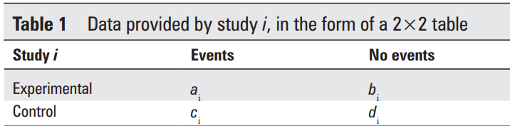
Arcsine difference
This approach calculates the treatment effect from each study separately along with its SE.
It is done by using a measure called “arcsine difference” which is a function of a_{i} , b_{i} , c_{i} , and d_{i} in table below

Slide 20
Arcsine difference
After specific estimates of the arcsine difference, combined them using a standard fixed or random effects approach.
Advantages
Not required a continuity correction.
estimate even in the extreme case of having only double-zero studies in the meta-analysis.

Slide 21
Arcsine difference
Disadvantages
It is very hard to interpret, thus this method has not been used in practice very often.
It may however be valuable as a secondary analysis, to assess the robustness of results.

Slide 22
Other methods
Exact method based on combining CIs
A bivariate binomial-normal model
A hypergeometric normal model
A Poisson-gamma model

Slide 23
Illustrative case study
Two independent meta-analyses
The author analyzed by inverse variance with 0.5 continuity correction.
The first one included 18 trials that compare long-acting injectable antipsychotics (LAI-AP) to placebo, for all cause mortality.

Slide 24
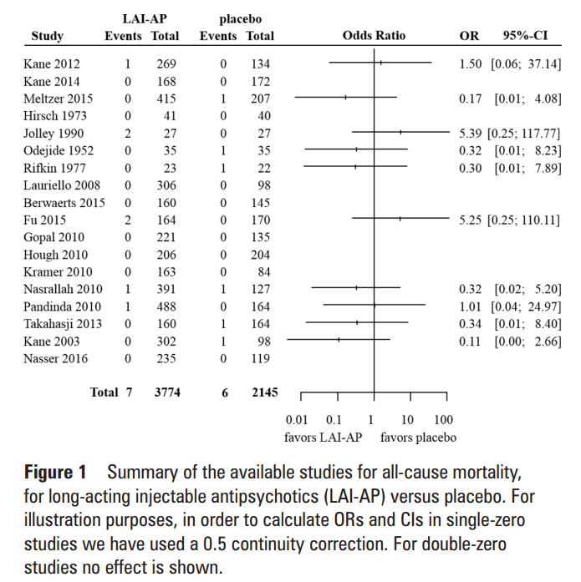

Slide 25
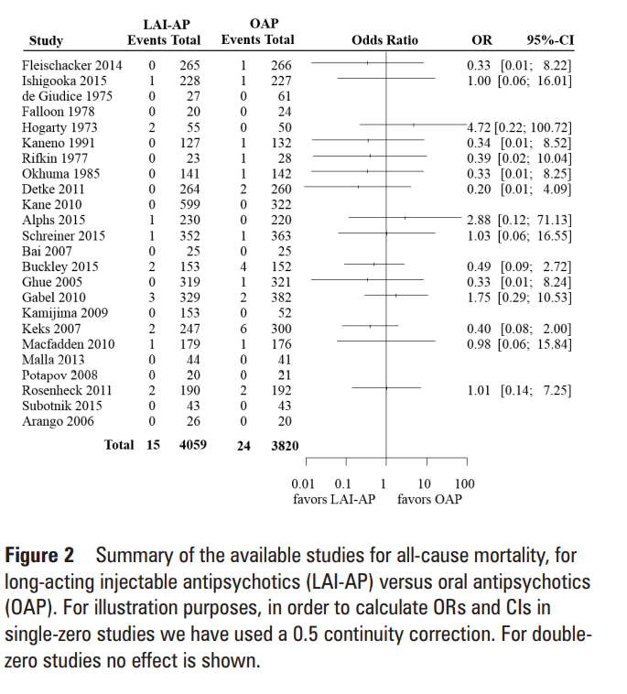

Slide 26
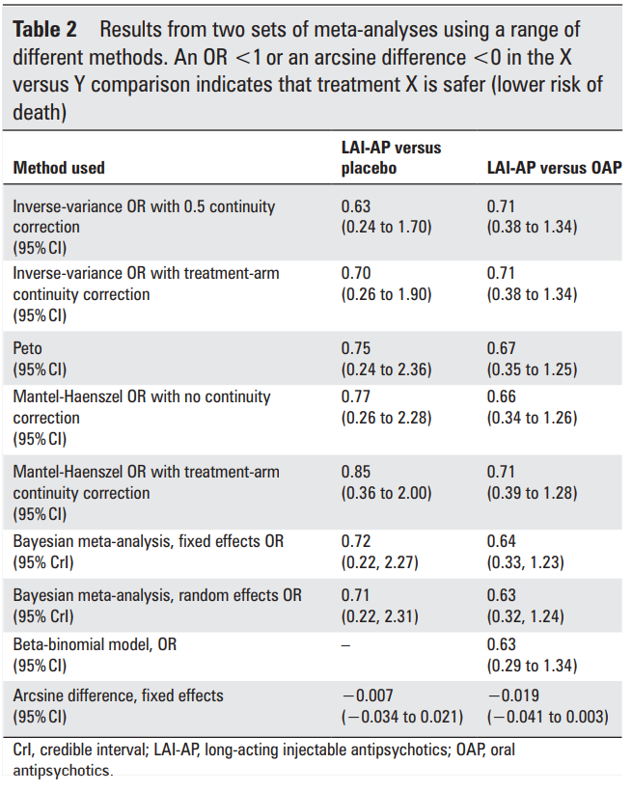
Notes:
The summarized results from all analyses are shown in table 2. as you can see that the choice of the method for meta-analysis is more important in the first example as compared with the second one. This is because events in the first data set were sparser
This finding highlights a more general conclusion, that is the sparser the data, the larger impact of the choice of meta-analysis method.
Let’s look at the first example, we can easily see that using a continuity correction either 0.5 or the treatment-arm continuity correction leads to narrow CIs compare with other methods. Different choices of the continuity correction lead to different results.
The peto’s method gives similar,, but not identical results to MH with no nontinuity correction,. But petos’ method might be subobtimal for this example , as there are studies with large imbalances with 3:1 randomization ratio
The fixed effect Batesian model gave almost identical results to the MH approach without continuity correction.
The effect of modelling random effects was rather minimal in both analyses, as the estimated value for heterogeneity was small.
The beta binomial model failed to converge for the first example. , the second example it gave results comparable to the rest of the methods
And finally the result from the arcsine difference meta-analysis. interpreting this effect measure in a clinically meaning ful way can be very difficult

Slide 27
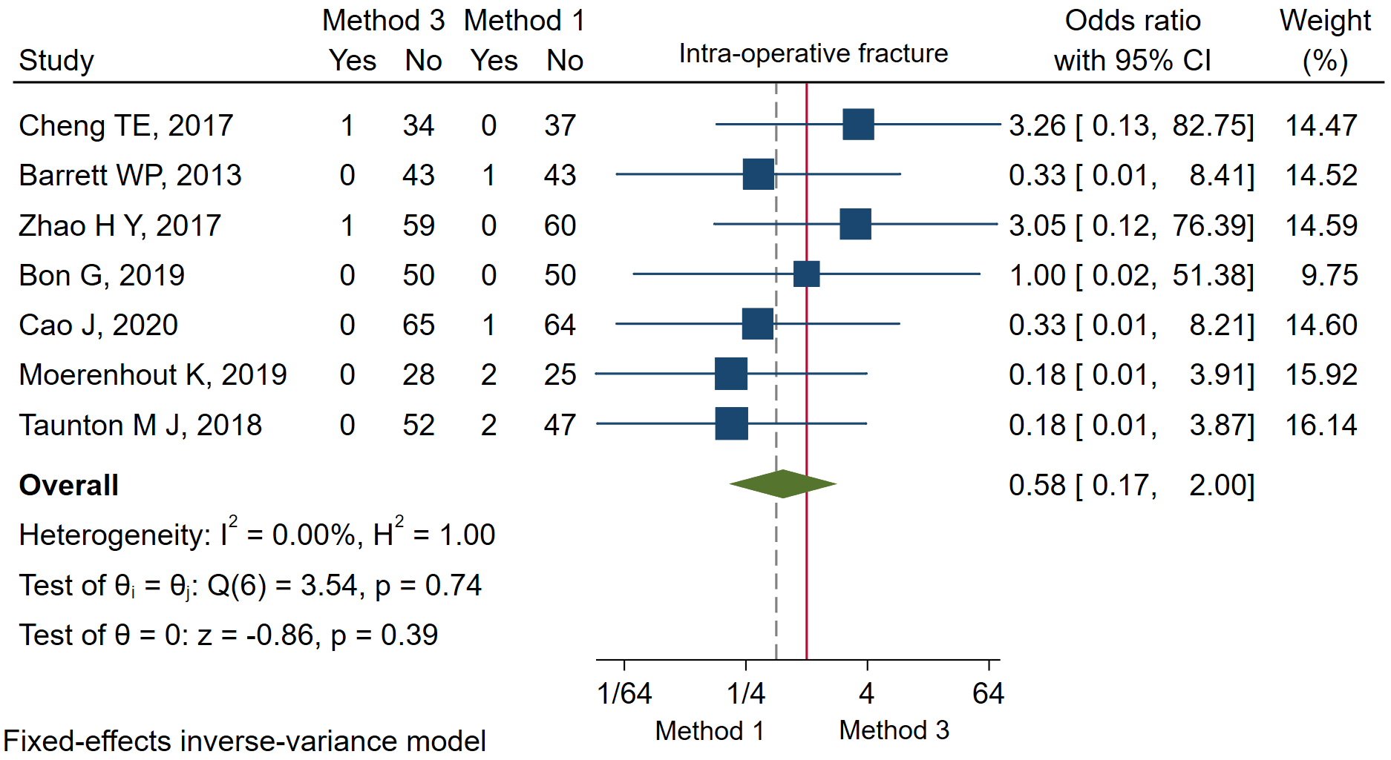
IV-OR

Slide 28
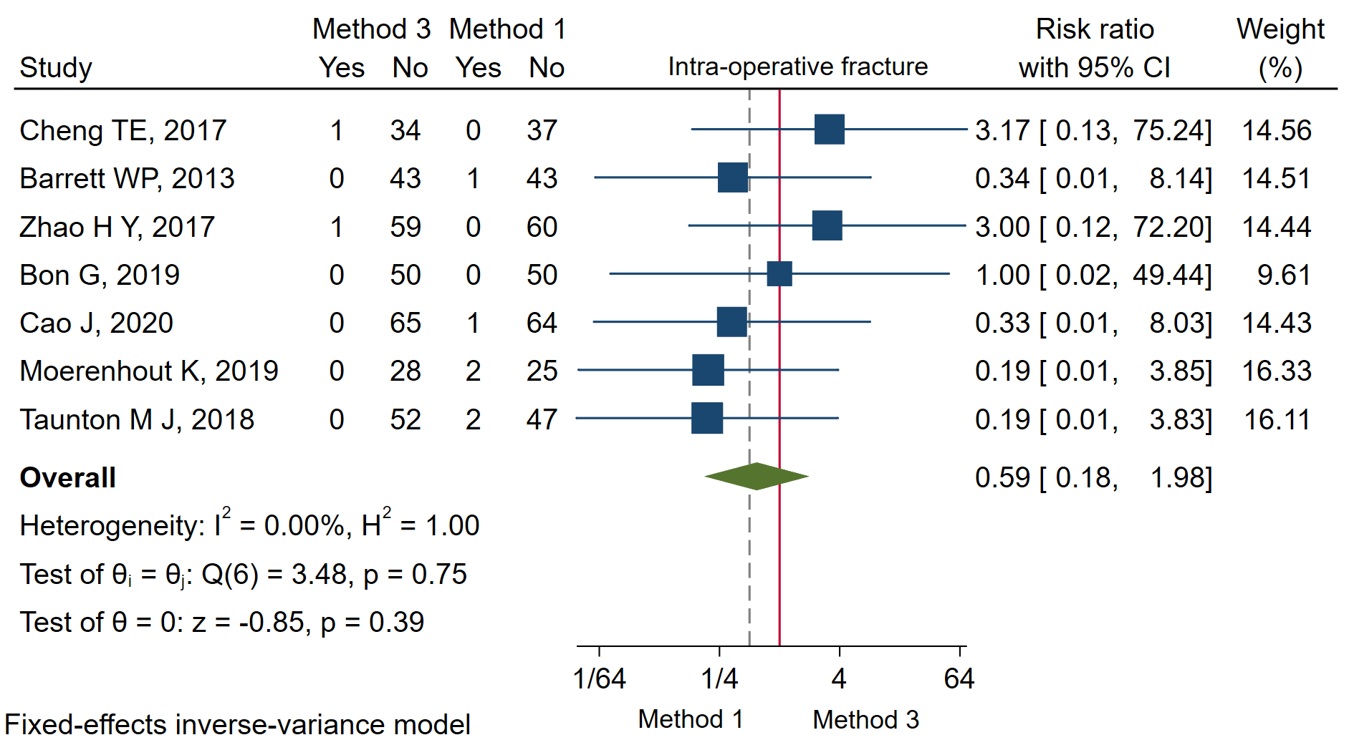
IV-RR

Slide 29
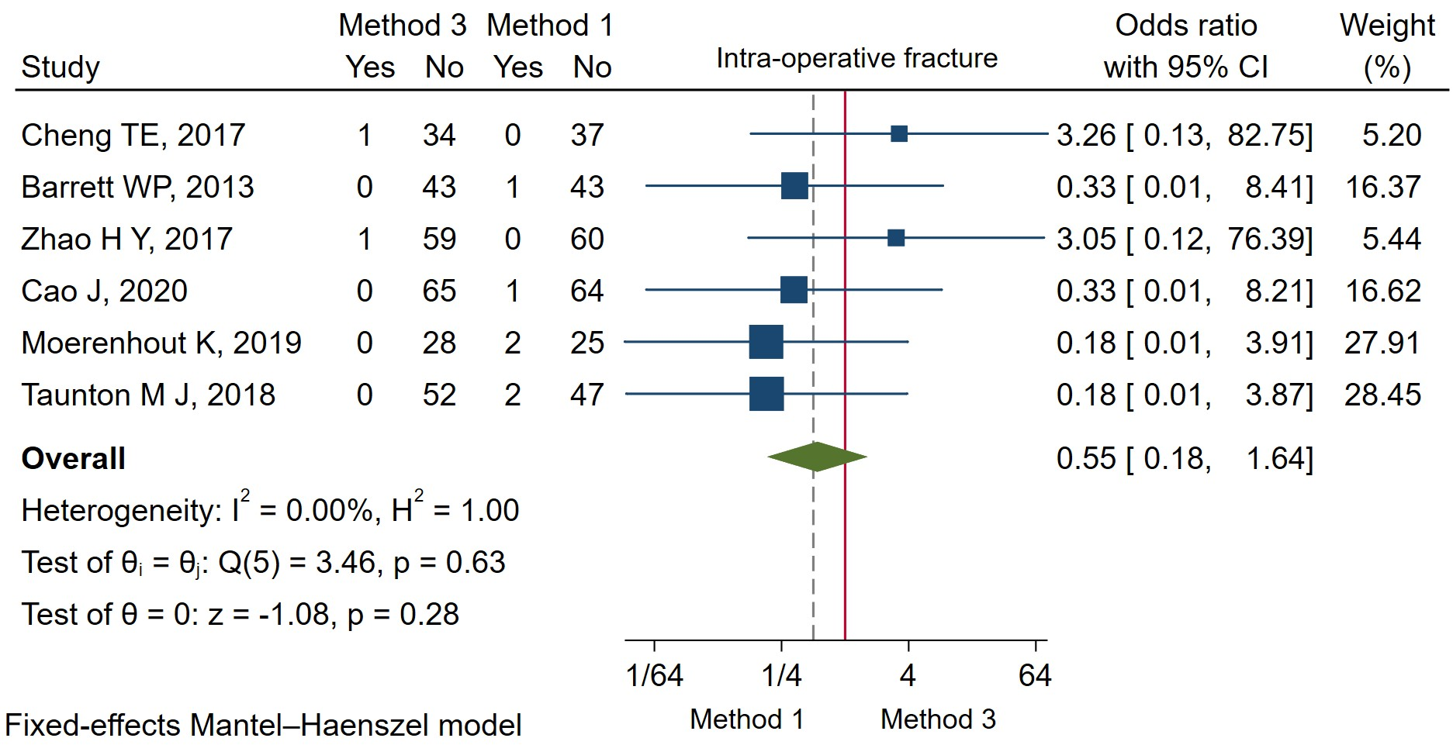
MH-OR

Slide 30
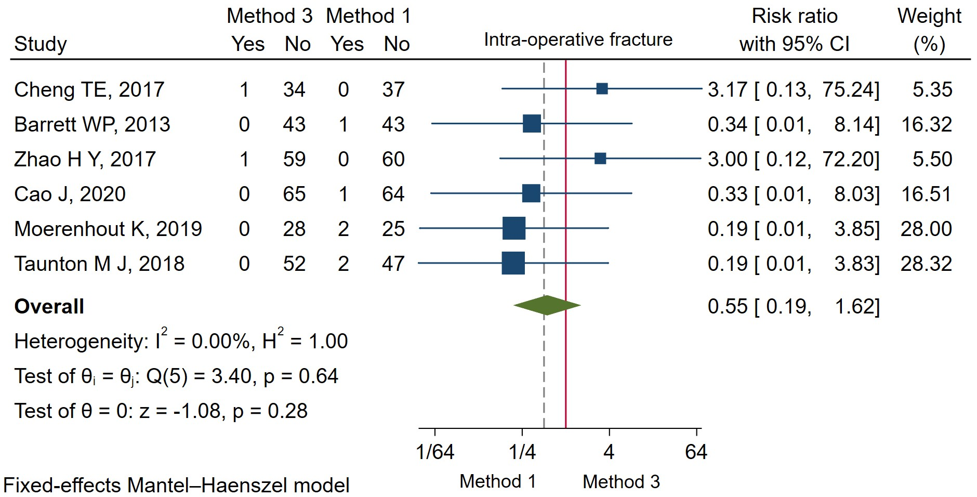
MH-RR

Slide 31
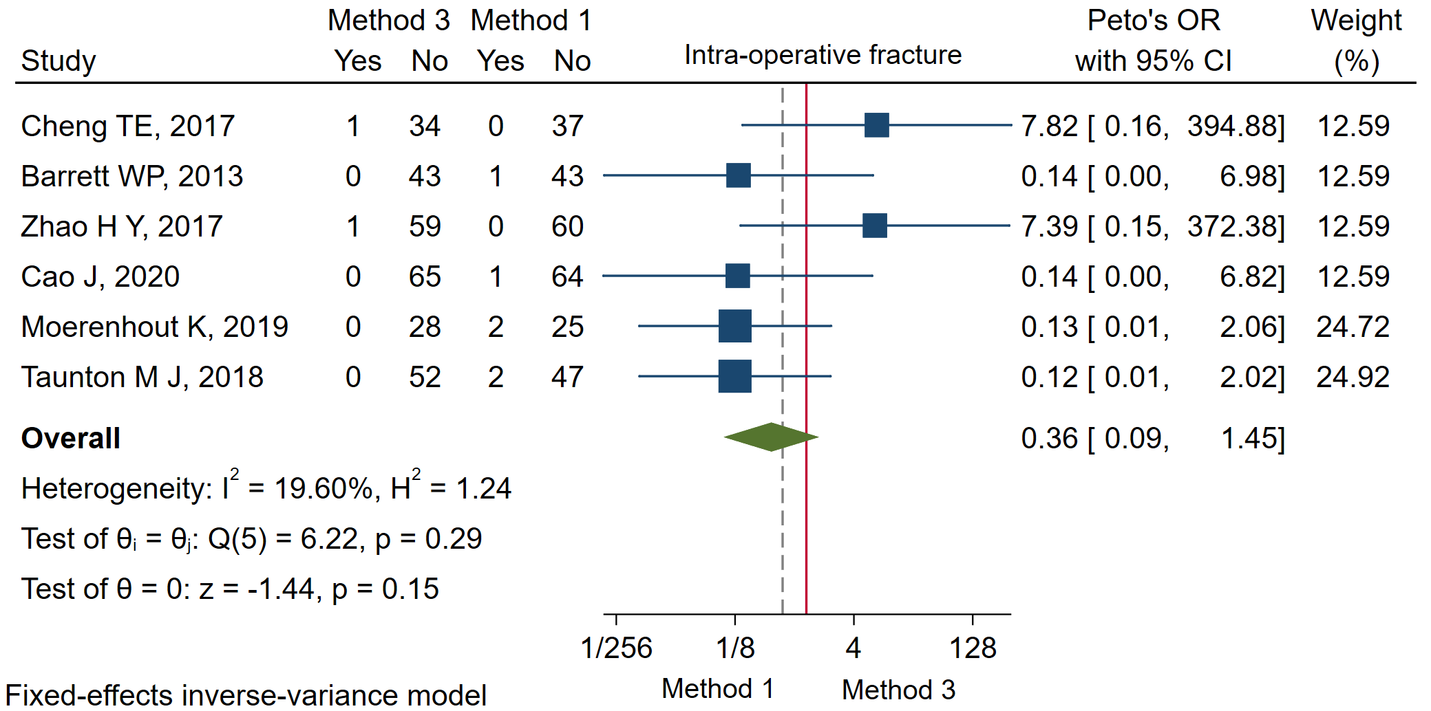
Peto’s OR

Slide 32
Example
Methods used | Method 3 vs 1
IV with 0.5 continuity correction,OR | 0.58 (0.17 , 2.00)
IV with 0.5 continuity correction,RR | 0.59 (0.18 , 1.98)
MH-OR | 0.55 (0.18 , 1.64)
MH-RR | 0.55 (0.19, 1.62)
Peto’s OR | 0.36 (0.09 , 1.45)

Slide 33
General considerations
The artificial continuity corrections should be avoided.
Risk difference is usually not the optimal effect measure to use.
Peto’s method should not be employed when the three conditions needed are not met
Event rates <1%
Balanced groups
Small treatment effects
In such circumstances the MH ORs without continuity correction perform better than Peto’s.

Slide 34
General considerations
The beta-binomial model has been shown in simulations to outperform other methods in some settings, but might suffer from issues regarding convergence of the model.
Bayesian meta-analysis with informative prior distributions is a good way to include random effects in the meta-analysis. This is because it overcomes the problem of estimating heterogeneity when events are sparse.

Slide 35
General considerations
Results regarding relative effects (odds/risk ratios) should always be presented along with absolute incidence rates, to put results into context.
Meta-analysis should avoid labelling results as statistically significant or non-significant. The use of arbitrary cut-points for p value can be even more problematic, because results might be affected by the choice of model.

Slide 36
Finally, researchers should predefine an analysis plan to avoid selective use of methods.
In addition, when events are rare, meta-analysts should always perform extensive sensitivity analyses using a range of alternative methods, to ensure the robustness of their results.

Slide 37
When results are very sensitive to the choice of model, researchers should be cautious on how they present and interpret their finding.
In such cases, results should be considered exploratory and hypothesis generating.

Slide 38
Q&A

