Slide 1
A proposed framework to guide evidence synthesis practice for meta-analysis with zero-events studies
Lertkong Nitiwarangkul, MD.

Slide 2
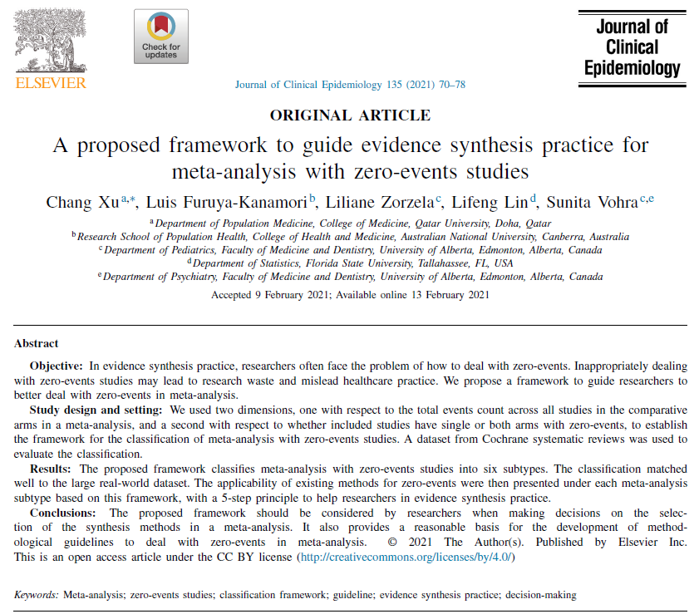
Notes:
Publish in journal of Epidemiology in year 2021 I’m the one who face with this problem in my umbrella review in the part of re-pool data
So I choose this topic for today meeting
Hope this information will useful for you all too.

Slide 3
Outline
Introduction
Classification for meta-analysis with zero-events studies
Rationale for the classification
Real world data for classification
How to use the framework for evidence synthesis practice
Discussion

Slide 4
Outline
Introduction
Classification for meta-analysis with zero-events studies
Rationale for the classification
Real world data for classification
How to use the framework for evidence synthesis practice
Discussion

Slide 5
Introduction
Meta-analysis has been widely used to synthesis evidence for studies
Rare event from
Small sample size
Risk of event is low
Short follow-up period
Face the problem of how to deal with zero-events
Notes:
From 500 random search SR MA → 30-34% face of zero event

Slide 6
Introduction
Inappropriately dealing with zero-events studies
Lead to research waste and mislead healthcare practice
This study propose a framework to guide researchers

Slide 7
Introduction
Most effect measures in meta-analysis for Binary outcome
Relative measures
Risk ratio (RR)
Odd ratio (OR)
In the presence of zero-events,
Hard to calculate the RR and OR → denominators are zero
Absolute measure
Risk difference (RD)
No problem about calculation: no denominators use

Slide 8
Introduction
Classic classification to deal with zero event
Single- arm-zero-events studies, where zero-events only occur in one of the arms
Double-arm-zero-events studies, where zero-events occur in both arms
Foundation for statisticians
Current recommendations still rely on this classification
Notes:
-Variances of all RR, OR, and RD could not be defined using the classical delta method
-Variance of RD for zero-events has been well-addressed
-Still not achieved to handle zero-events for the RR and OR

Slide 9
Introduction
Single-arm- zero-events studies (Recommend)
Peto’s OR
Mantel–Haenszel (MH)
Double-arm-zero-events studies
Most software automatically discard them from a meta-analysis (e.g., RevMan V.5.4.1)
Notes:
Peto’s OR: good in single arm but poor in double arm

Slide 10
Exclude study with double-arm-zero-events
Could be problematic: both clinical and statistical
These studies contribute an important source of evidence
Discarding them is a deviation of the principle of EBM
Lead to research waste.
These studies are not necessarily “noninformative,”
Depending on the methods used to synthesize them
For example, for studies with balanced sample sizes → zero-events in both arms indicate comparable treatment effects

Slide 11
Exclude study with double-arm-zero-events
Excluding of these studies
Can result in about 10% of the meta- analyses change the statistical significance

Slide 12
Outline
Introduction
Classification for meta-analysis with zero-events studies
Rationale for the classification
Real world data for classification
How to use the framework for evidence synthesis practice
Discussion

Slide 13
Classification for meta-analysis with zero-events studies
Treats the whole meta-analysis as a unit
Instead of each study as a unit
Classify meta-analysis with zero-events studies into different subtypes

Slide 14
Two Dimensions of Classification
1. Two types of meta-analysis
Total events count is zero in one arm or in both arms
Total events count is zero in neither arm (i.e., total events > 0 in both arms)
2. Distribution of zero-events studies in a meta-analysis
Only single-arm-zero-events studies
Only double-arm-zero-events studies
Mixture of both single-arm-zero-events and double-arm-zero-events studies

Slide 15
Two dimensions to 6 subtypes
Type of zero event | Description
 | Individual study | Total event
1. MA-SZ | Single arm | Neither arm is zero
2. MA-MZ | Single & Double arm | Neither arm is zero
3. MA-DZ | Double arm | Neither arm is zero
4. MA-CSZ | Single | Total in one arm is zero
5. MA-CMZ | Single & Double arm | Total in one arm is zero
6. MA-CDZ | Double arm | Total in both arm are zero

Slide 16
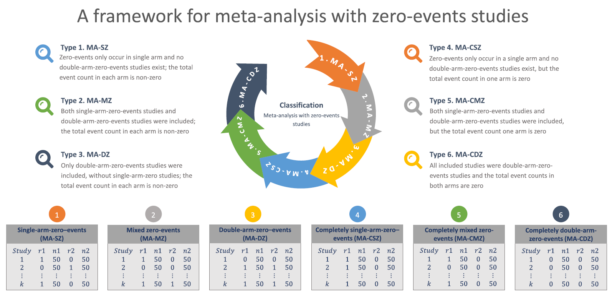

Slide 17
Outline
Introduction
Classification for meta-analysis with zero-events studies
Rationale for the classification
Real world data for classification
How to use the framework for evidence synthesis practice
Discussion

Slide 18
Current method of zero event
Classified as
One-stage approach
Two stage approach
Standard meta-analysis approach
First stage: Study-specific effect sizes and standard errors are obtained or estimated from the included studies
Second stage: Synthesized

Slide 19
Two stage approach: Available methods
Continuity/empirical correction
Peto’s OR: Single arm zero event
Mantel-Haenszel technique (MH)
Two-stage Bayesian methods
The exact p -function method
The arcsine- based transformation (e.g., arcsine difference)
These methods are estimation methods
Used at the first stage to obtain the study-specific effects;
Not meta-analytic methods
Meta- analytic methods refer to as a type of “weighted average” procedure

Slide 20
One stage approach
No need to obtain study-specific effect sizes
Each study is treated as a stratum
Overall effect size → obtained by the “population average method”
Available methods for “one stage approach”
Generalized linear mixed models (GLMMs)
Generalized estimating equations (GEEs)
Stratified exact regression
One-stage Bayesian methods
Beta-binominal methods

Slide 21
One stage approach
Valid solution to synthesize studies with zero-events in both arms
Cannot be used in total events count is zero
Due to Problem of separation
MA-CSZ, MA-CMZ, and MA-CDZ, most of the one- stage methods → not applicable
Distinguish in Dimension 1
Notes:
ถ้า total event count = 0 (MA-CSZ, MA-CMZ, and MA-CDZ) → 1 stage approach ใช้ไม่ได้ → พิจารณาใน Dimension แรก
One stage Valid solution to synthesize studies with zero-events in both arms
แต่ถ้า total event count = 0 (MA-CSZ, MA-CMZ, and MA-CDZ) → 1 stage approach ใช้ไม่ได้ → พิจารณาใน Dimension แรก
เพราะฉะนั้นที่มี ตัว C ปน ใช้ไม่ได้
Two stage approach Valid solution to synthesize studies with zero-events in single arms
เพราะฉะนั้น double arm ทั้งหมด ใช้ไม่ได้ คือ ที่มีตั้ว D หรือ M ปน

Slide 22
Two stage approach
Valid solution to synthesize studies with zero-events in single arm
Most of the two- stage methods are not appropriate for zero event in double arm
Measure RR in MA-MZ, MZ-DZ, MA-CMZ, and MA- CDZ,
For example, the Peto’ OR, the MH OR/RR
Distinguish in Dimension 2
Notes:
One stage Valid solution to synthesize studies with zero-events in both arms
แต่ถ้า total event count = 0 (MA-CSZ, MA-CMZ, and MA-CDZ) → 1 stage approach ใช้ไม่ได้ → พิจารณาใน Dimension แรก
เพราะฉะนั้นที่มี ตัว C ปน ใช้ไม่ได้
Two stage approach Valid solution to synthesize studies with zero-events in single arms
เพราะฉะนั้น double arm ทั้งหมด ใช้ไม่ได้ คือ ที่มีตั้ว D หรือ M ปน

Slide 23
Outline
Introduction
Classification for meta-analysis with zero-events studies
Rationale for the classification
Real world data for classification
How to use the framework for evidence synthesis practice
Discussion

Slide 24
Real-world data
Data from Cochrane Database of Systematic Reviews (CDSR)
21,288 meta-analyses were identified with zero-events studies (34.85%)
MA-SZ was the most common subset
19,308 (90.70%) meta-analyses
Notes:
MA publish from 2003 to 2018

Slide 25
Outline
Introduction
Classification for meta-analysis with zero-events studies
Rationale for the classification
Real world data for classification
How to use the framework for evidence synthesis practice
Discussion

Slide 26
Evidence synthesis
Degree of difficulty in synthesizing evidence increases gradually from subtype 1 to 6
As shown in next figure

Slide 27
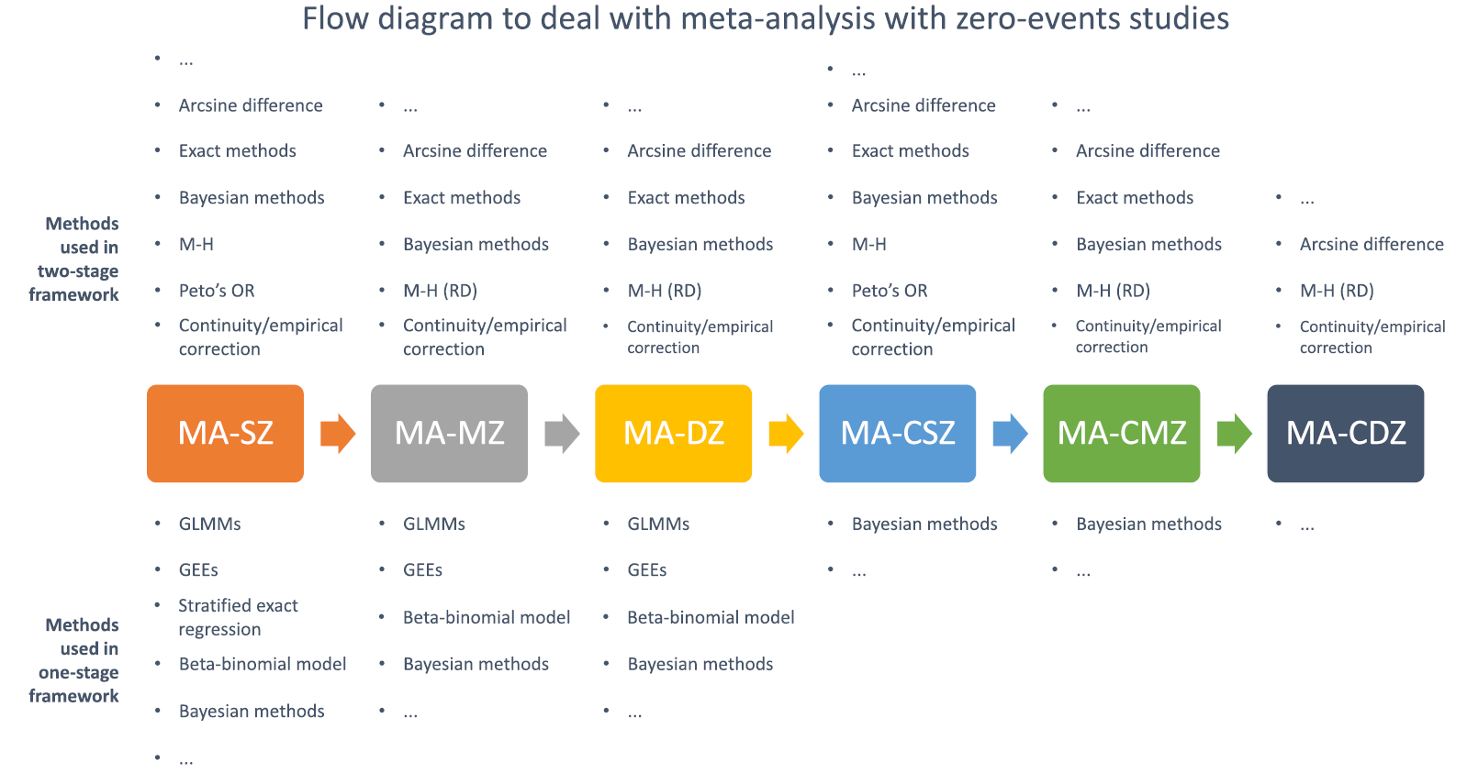
Notes:
Peto’s OR for single arm zero event only MA-SZ and MA-CSZ GLMMs use in neither arm total event = 0

Slide 28
5 steps of evidence synthesis
1. Check for zero event study (Classification?)
2. Compare with the framework → classified as…
3. Use flow diagram and choose the method that available for evidence synthesis
4. Conduct meta-analysis by using one or more appropriate methods
5. Conduct sensitivity using other available methods to test whether the results are robust
Notes:
จะเอา example in page 74 75 เข้าไปมั้ย

Slide 29
Outline
Introduction
Classification for meta-analysis with zero-events studies
Rationale for the classification
Real world data for classification
How to use the framework for evidence synthesis practice
Discussion

Slide 30
Discussion
In the flow diagram, we did not list the methods for relative and absolute measures
Just indicated which methods could be used with
Absolute risk (e.g., RD)
Relative measures (e.g., Peto’s OR)
Example
Mantel-Haenszel estimation (MH) in double arm zero event
Measuring the effect by the RD
Studies would be discarded when the MH method with OR/RR is utilized

Slide 31
Discussion
RD is an appealing effect estimator to deal with zero-events over the OR and RR
RD may increase the heterogeneity than OR and RR
Currently no consensus about the selection of effect estimator for rare events
Continuity/empirical correction is not routinely employed for studies with no events in both arms
Researchers have to do it manually in the program
Notes:
RD can be used to estimate NNT

Slide 32
Discussion
This framework is based on post hoc classification
Determine the subtype after the data for a meta-analysis are obtained
Recommend researcher to develop a synthesis plan in advance
Notes:
Plan in advance for facing with zero event
Researchers consider all six possible situations a priori and predefine one or more available methods for each situation in their protocols

Slide 33
Recommendation
Researchers should conduct a sensitivity analysis by using other available methods
Due to unstable nature of such types of meta-analysis as the total events in both arms are still rare
Leading to a large amount of uncertainty
Once there are conflicting results
No well-established evidence to support a preferred conclusion
However, for safety outcome
“At worst”principle
One presenting a more obvious signal of harms is the first concern

Slide 34
Discussion
Two additional recommendations
1. Estimate the minimal sample size for detecting a potential difference
Statistically non-significant results may be due to an insufficient sample size
2. Researcher should grade the certainty of the results
Judged along with the power-analysis results
Notes:
For the selection of concrete methods to deal with zero- events studies, there is currently no universal consensus on which method should be used

Slide 35
Discussion
Researcher should avoid
1. Not recommended to use continuity correction (adding 0.5) when the sample sizes of the two arms are imbalanced
Lead to large bias or even reverse the effects
2. Not recommended to use Bayesian methods when most or all the included studies are both-arm-zero-events studies
3. Not recommended to use the “treat-as-one trial” method
Adding the cases and sample sizes together of included studies,
Lead to Simpson’s paradox and mislead the healthcare practice
4. For safety outcomes; Not suggested to use the conservative analytic model (e.g., random-effect model)
Notes:
For No.1 Recommend: Empirical correction could be an alternative for continuity correction in this case
ข้อ 1 ใช้ MH แทน กรณี imbalance

Slide 36
“incorporation of heterogeneity into an estimate of a treatment effect should be a secondary consideration when attempting to produce estimates of effects from sparse data –the primary concern is to discern whether there is any signal of an effect in the data ”

Slide 37
Thank you for your attention

Slide 38
Example
Zero event study

Slide 39
5 steps of evidence synthesis
1. Check for zero event study (Classification?)
2. Compare with the framework → classified as…
3. Use flow diagram and choose the method that available for evidence synthesis
4. Conduct meta-analysis by using one or more appropriate methods
5. Conduct sensitivity using other available methods to test whether the results are robust
Notes:
จะเอา example in page 74 75 เข้าไปมั้ย

Slide 40
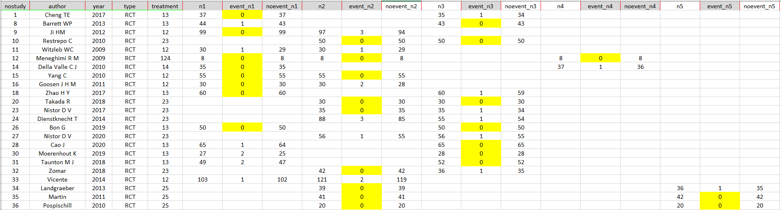

Slide 41
5 steps of evidence synthesis
1. Check for zero event study (Classification?)
2. Compare with the framework → classified as…
3. Use flow diagram and choose the method that available for evidence synthesis
4. Conduct meta-analysis by using one or more appropriate methods
5. Conduct sensitivity using other available methods to test whether the results are robust
Notes:
จะเอา example in page 74 75 เข้าไปมั้ย

Slide 42
Two dimensions to 6 subtypes
Type of zero event | Description
 | Individual study | Total event
1. MA-SZ | Single arm | Neither arm is zero
2. MA-MZ | Single & Double arm | Neither arm is zero
3. MA-DZ | Double arm | Neither arm is zero
4. MA-CSZ | Single | Total in one arm is zero
5. MA-CMZ | Single & Double arm | Total in one arm is zero
6. MA-CDZ | Double arm | Total in both arm are zero

Slide 43
5 steps of evidence synthesis
1. Check for zero event study (Classification?)
2. Compare with the framework → classified as…
3. Use flow diagram and choose the method that available for evidence synthesis
4. Conduct meta-analysis by using one or more appropriate methods
5. Conduct sensitivity using other available methods to test whether the results are robust
Notes:
จะเอา example in page 74 75 เข้าไปมั้ย

Slide 44
Notes:
Peto’s OR for single arm zero event only MA-SZ and MA-CSZ GLMMs use in neither arm total event = 0

Slide 45
5 steps of evidence synthesis
1. Check for zero event study (Classification?)
2. Compare with the framework → classified as…
3. Use flow diagram and choose the method that available for evidence synthesis
4. Conduct meta-analysis by using one or more appropriate methods
5. Conduct sensitivity using other available methods to test whether the results are robust
Notes:
จะเอา example in page 74 75 เข้าไปมั้ย

Slide 46
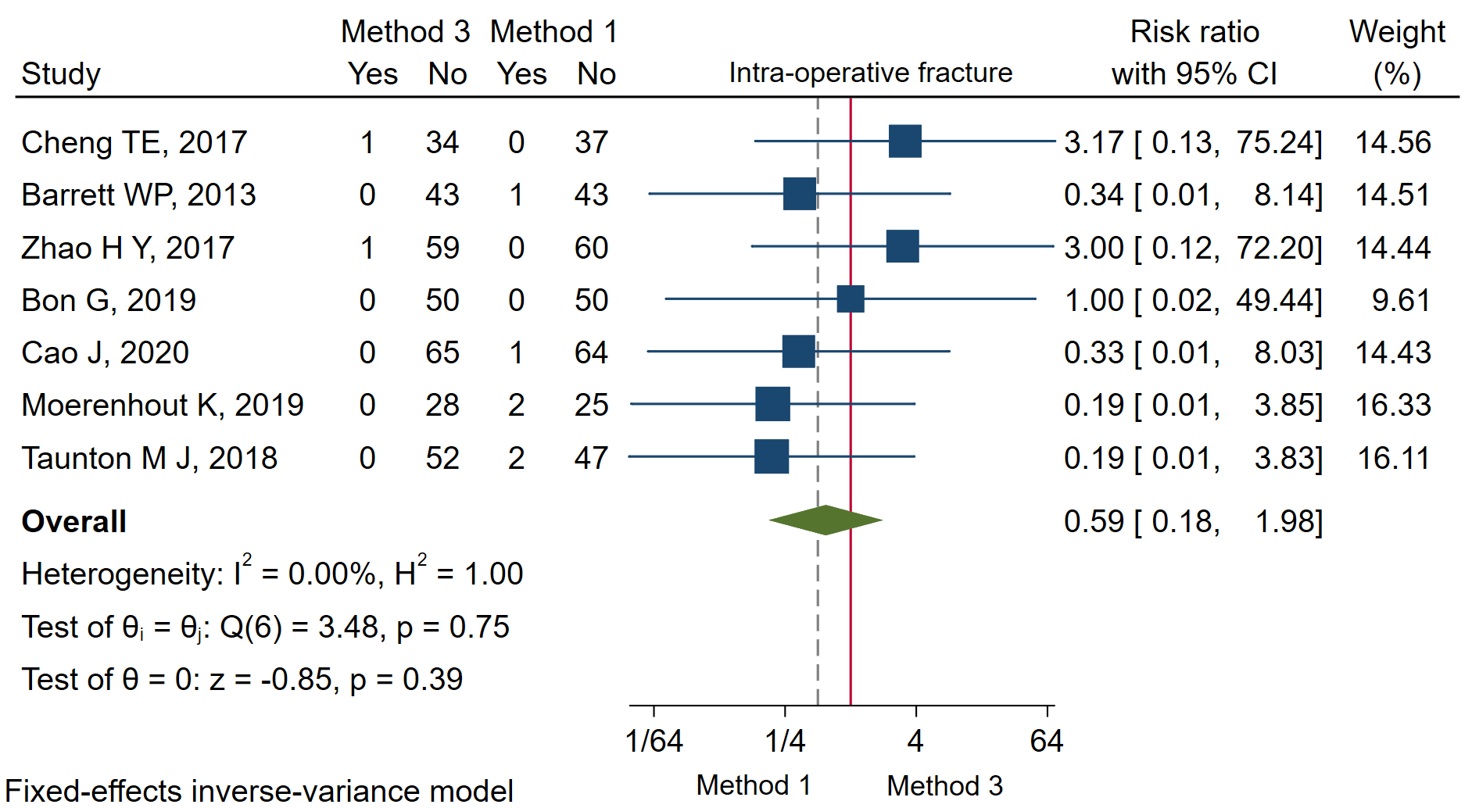
Intra-op fracture 13 (IV) RR

Slide 47
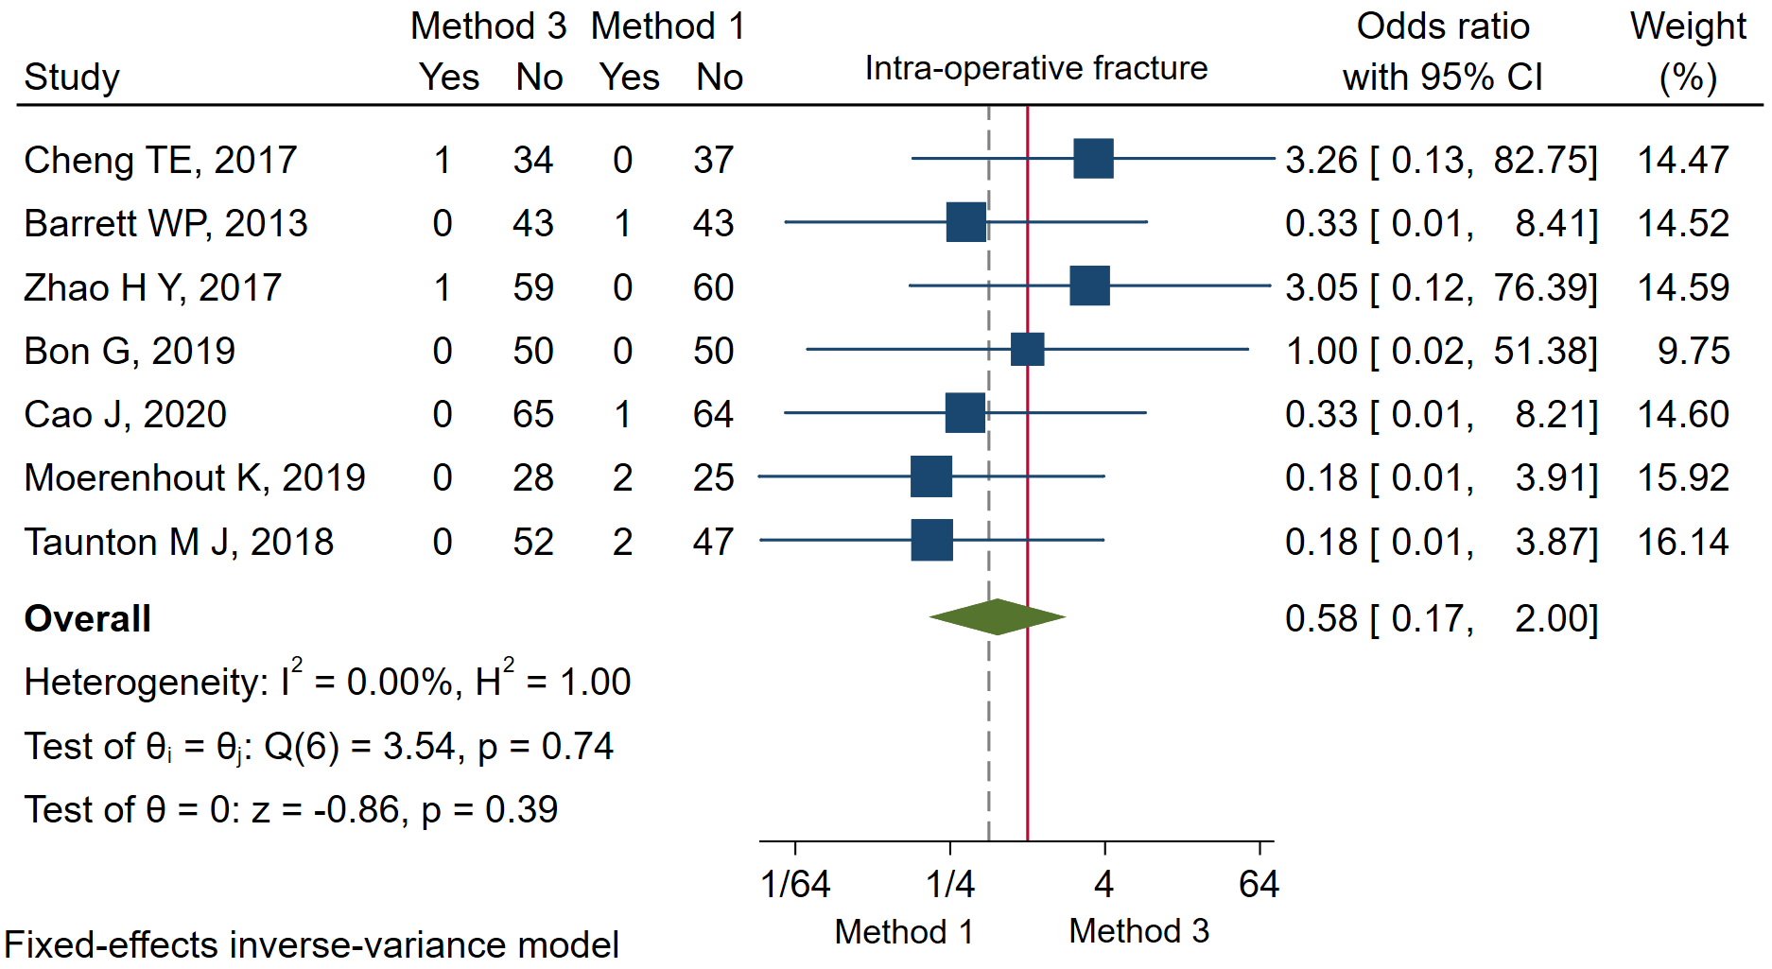
Intra-op fracture 13 (IV) OR

Slide 48
5 steps of evidence synthesis
1. Check for zero event study (Classification?)
2. Compare with the framework → classified as…
3. Use flow diagram and choose the method that available for evidence synthesis
4. Conduct meta-analysis by using one or more appropriate methods
5. Conduct sensitivity using other available methods to test whether the results are robust
Notes:
จะเอา example in page 74 75 เข้าไปมั้ย

Slide 49
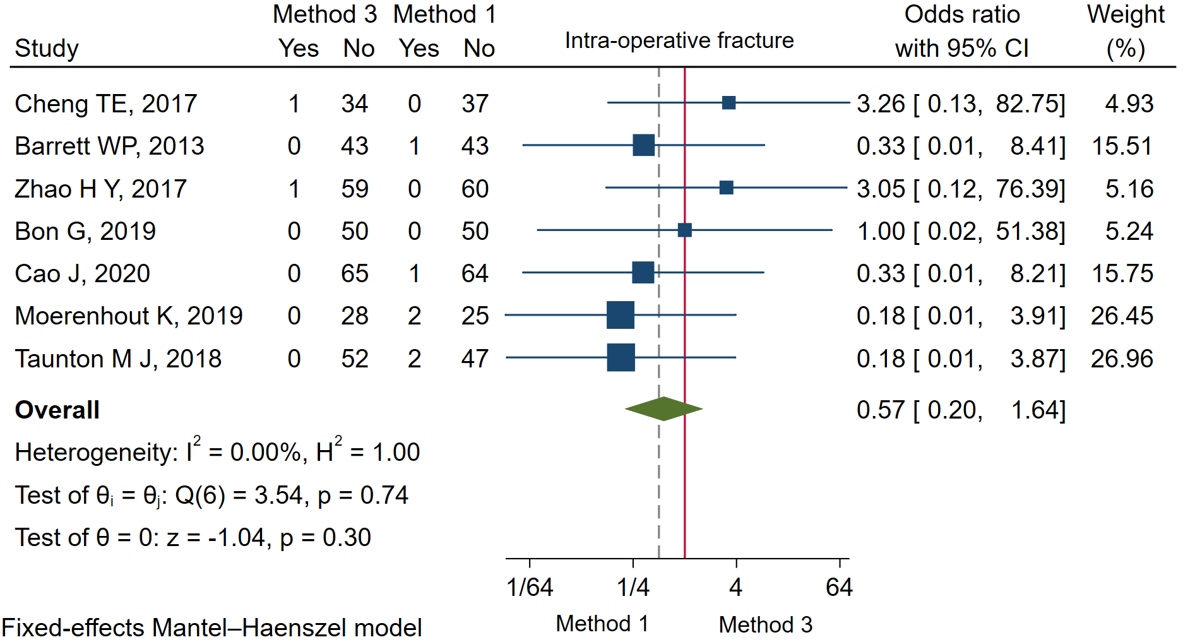
Intra-op fracture 13 (MH)

Slide 50
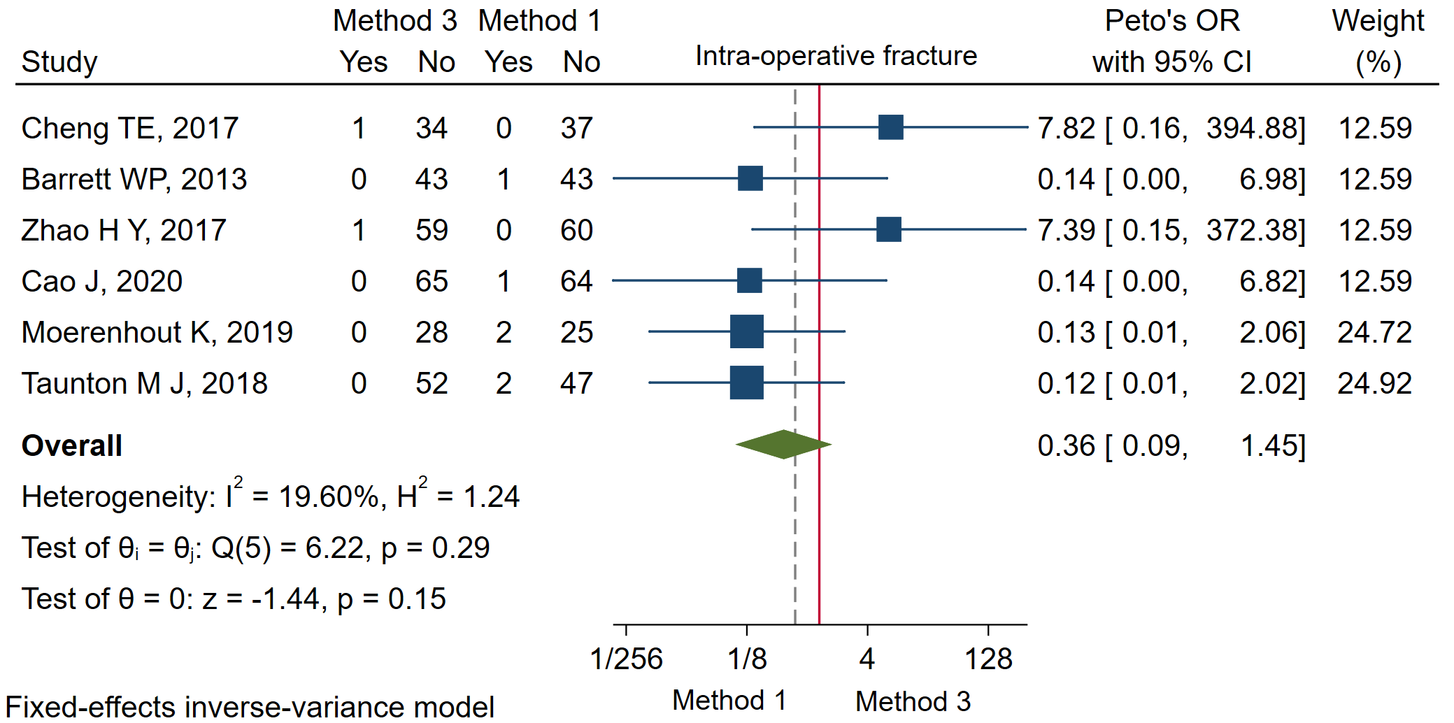
Intra-op fracture 13 (Peto’s OR)
Notes:
Excluded double arm zero study

